Slide 1
Istanbul Shopping Mall Analysis
By Ravali
99,457 Transactions
Excel + Power BI

Slide 2
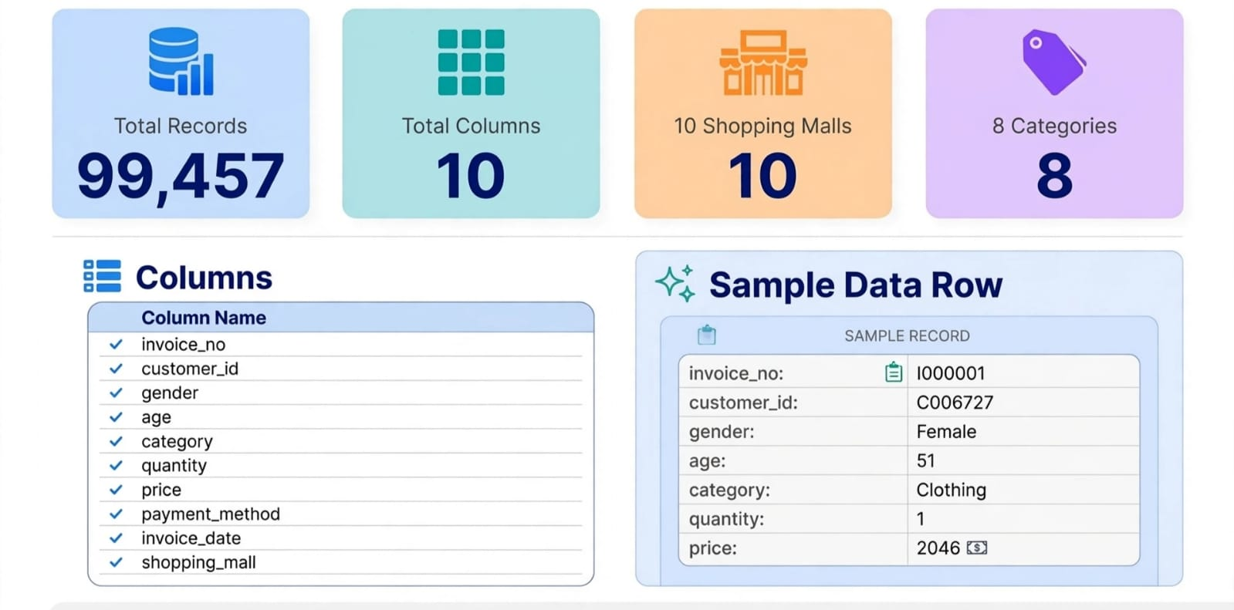
Dataset Name: Istanbul Shopping Mall Dataset
Source: Kaggle / Istanbul Mall Transaction Data 2022-2023
Total Size: 99,457 Rows × 10 Columns
Columns (10):
Invoice _ no: A combination of the letter 'I' and a 6-digit integer
uniquely assigned to each operation.
Customer _ id: A combination of the letter 'C' and a 6-digit integer
uniquely assigned to each operation.
gender: String variable of the customer's gender
age: Positive Integer variable of the customers age.
category: String variable of the category of the purchased product.
quantity: The quantities of each product (item) per transaction.
price: Product price per unit in Turkish Liras (TL).
Payment _ method: String variable of the payment method (cash, credit card or debit card) used for the transaction.
Invoice _ date: The day when a transaction was generated.
Shopping _ mall: String variable of the name of the shopping mall where the transaction was made.

Slide 3
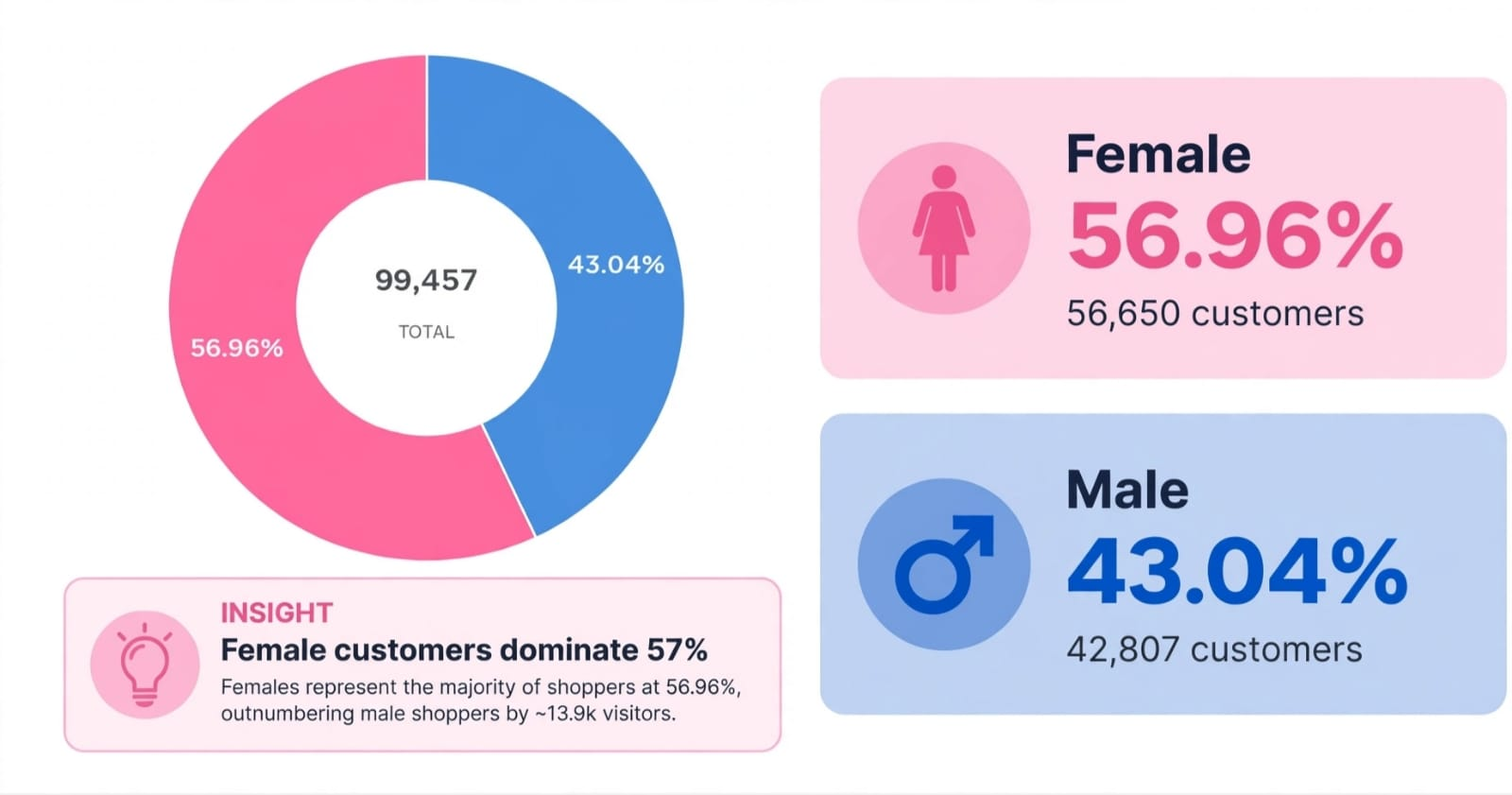
Title: Gender Distribution — Who Shops More?
Total: 99,457 customers
Female: 56.96% (56,650 customers)Male: 43.04% (42,807customers)
Difference: Female +13,843 more than Male

Slide 4
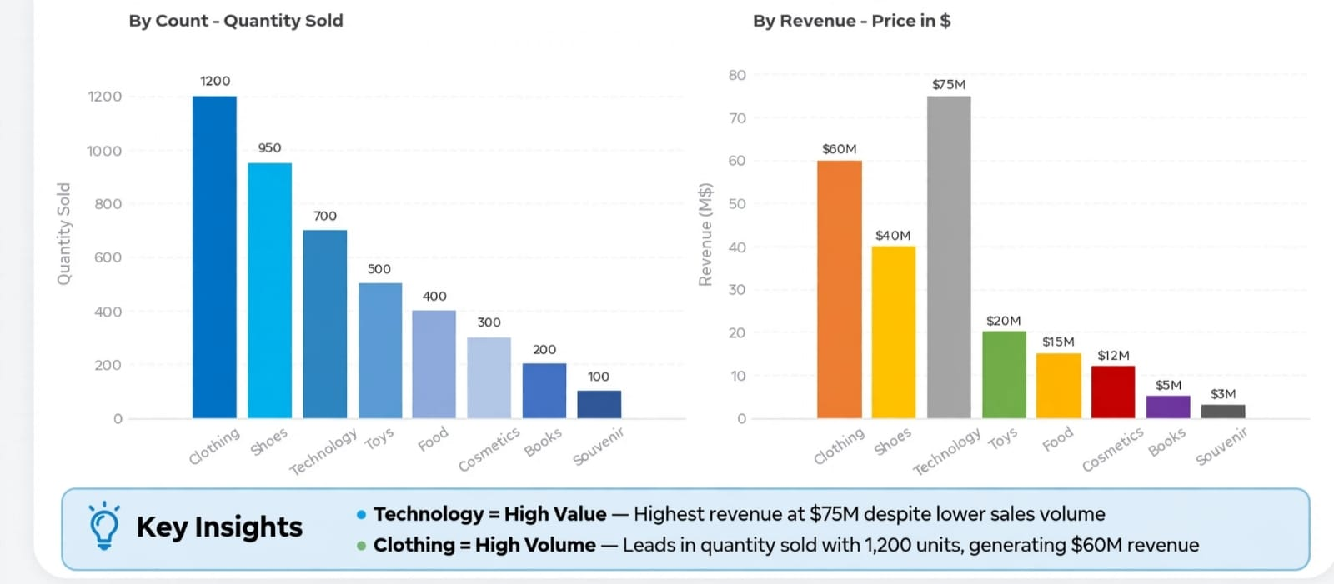
SLIDE 4: Category Analysis — Revenue vs Volume
Left Chart (By Count):
Clothing: 1200 units — #1 in Quantity
Shoes: 950, Technology: 700
Souvenir: 100 — Lowest
Right Chart (By Revenue):
Technology: $75M — #1 in Revenue (High price!
)Clothing: $60M — #2
Shoes: $40M
Books $5M, Souvenir $3M — Very Low

Slide 5
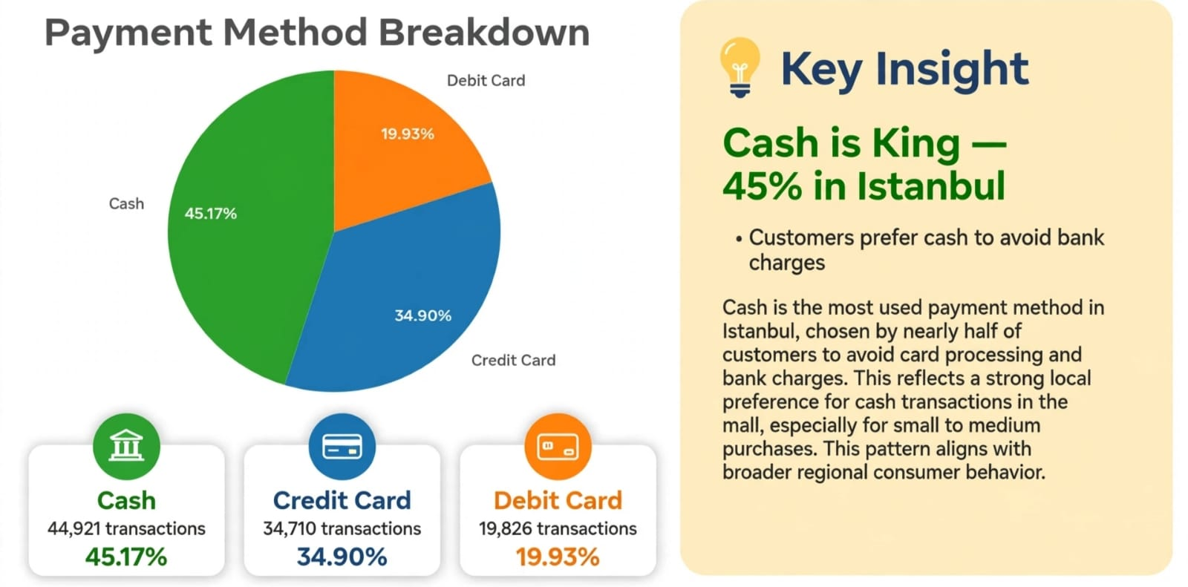
Title: Payment Method Analysis
Chart Data:
Cash: 45.17% — 44,921 transactions — #1
Credit Card: 34.90% — 34,710
Debit Card: 19.93% — 19,826

Slide 6
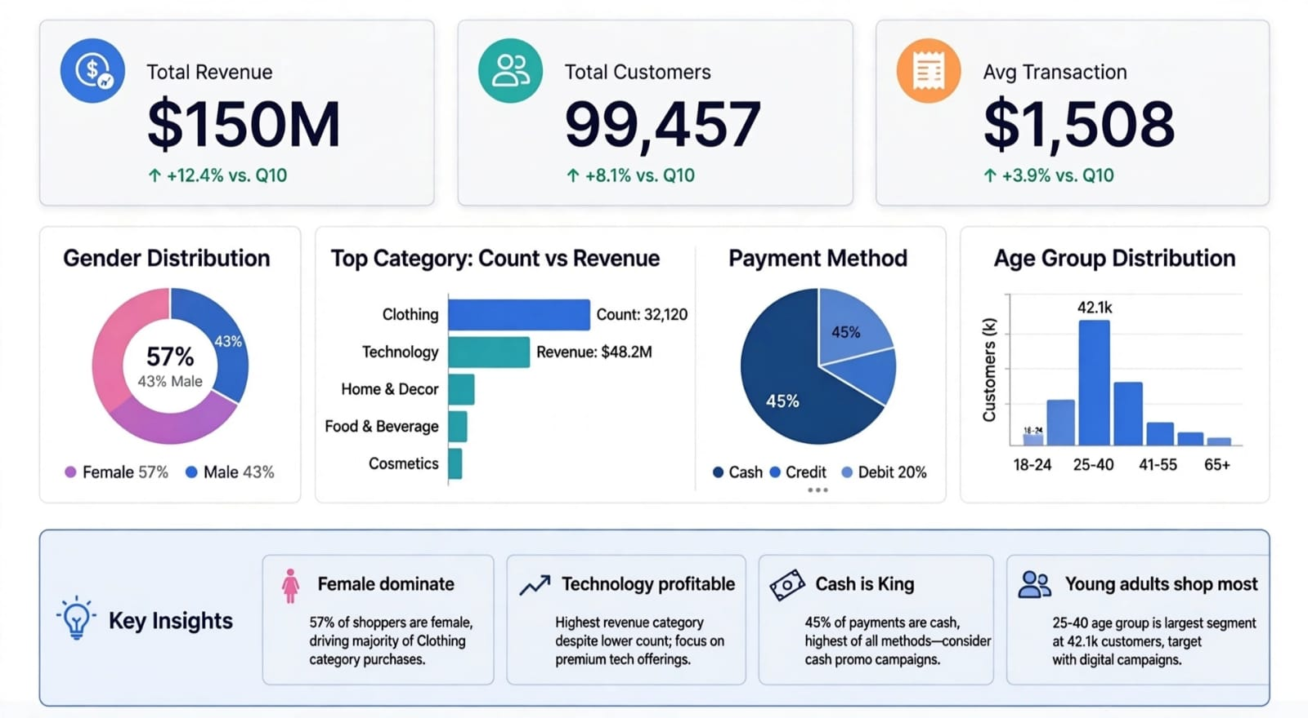
Title: Executive Dashboard — Final Conclusion
Top KPIs: "Total Revenue $150M, Total Customers 99,457 “
Gender: "Female 57% dominate
Category: "Clothing highest COUNT 32,120 but Technology highest REVENUE $48.2M
Payment: "Cash 45% is King
Age: "25-40 age group 42.1k — Young adults shop most

Slide 7
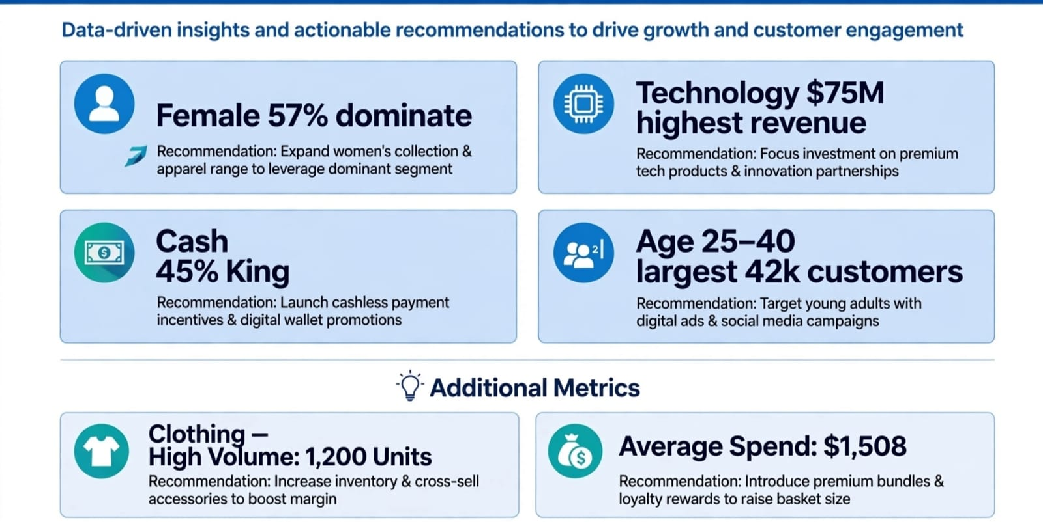
SLIDE 7: Key Insights & Strategic Recommendations
Female 57% dominate→ Recommendation: Expand women's collection & apparel range
2. Technology $75M highest revenue→ Recommendation: Focus investment on premium tech products
3. Cash 45% King→ Recommendation: Launch cashless payment incentives & digital wallet promos
4. Age 25-40 largest 42k customers→ Recommendation: Target young adults with digital ads & social media
5. Clothing — High Volume: 1,200 Units→ Recommendation: Increase inventory & cross-sell accessories
6. Average Spend: $1,508→ Recommendation: Introduce premium bundles & loyalty rewards

Slide 8
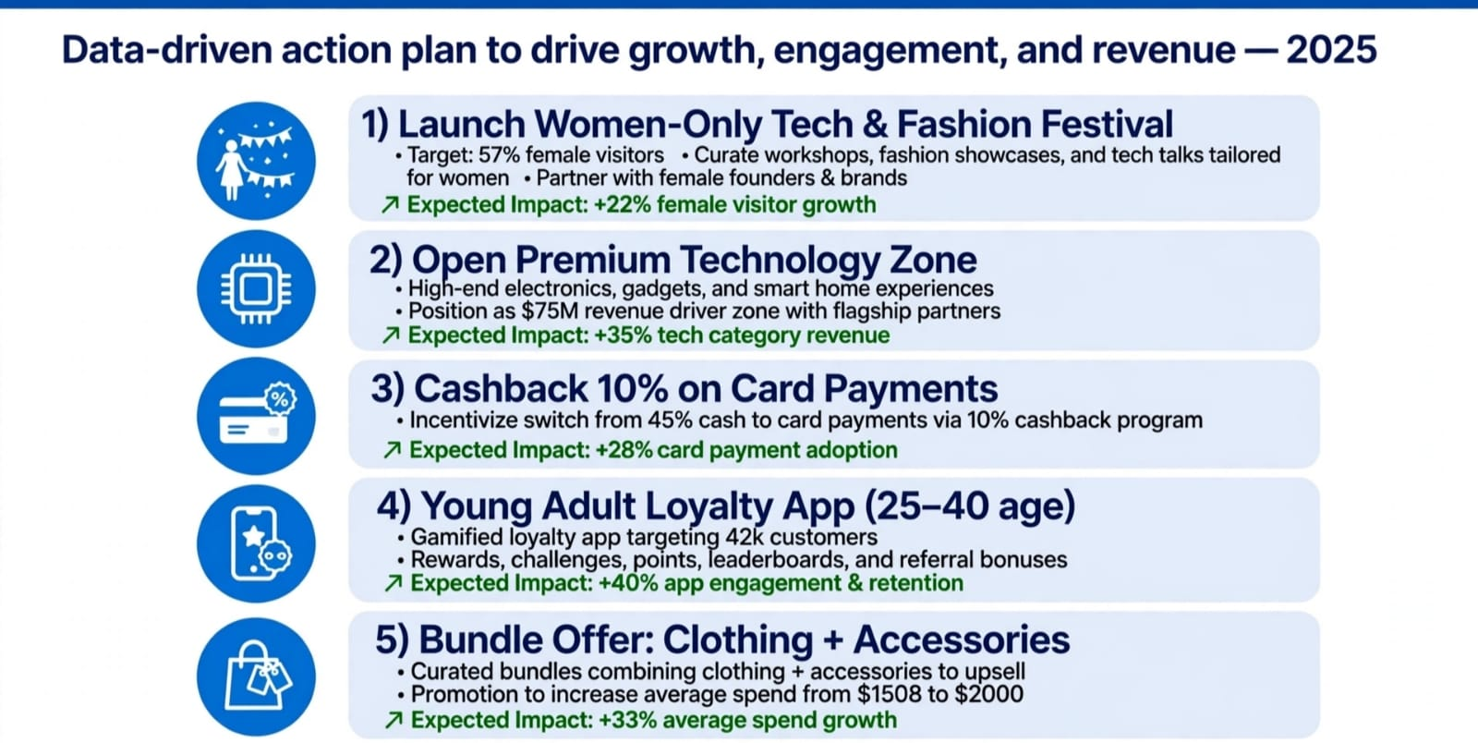
SLIDE 8: My 5 Suggestions
my analysis of 99,457 transactions, my 5 suggestions are:"
Women-Only Tech & Fashion Festival Target 57% female → Expected +22% growth
2) Premium Technology Zone$75M revenue driver → Expected +35% tech revenue
3) Cashback 10% on Card Payments Shift from 45% Cash → Expected +28% card adoption
4) Young Adult Loyalty App (25-40 age)Target 42k customers → Expected +40% retention
5) Bundle Offer: Clothing + Accessories Increase avg spend $1508 to $2000 → Expected +33% growth

Slide 9
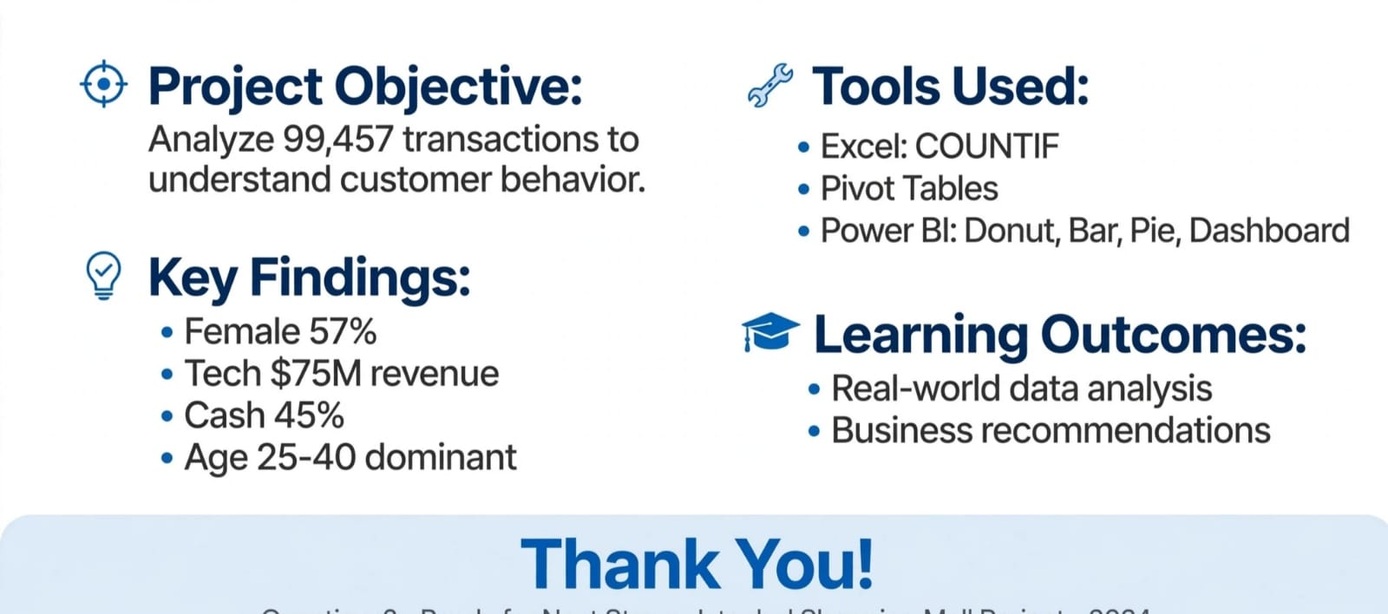
SLIDE 9: Conclusion
✅ Slide 1: Title (Make yourself: Your Name, Roll No)
✅ Slide 2: Q7 Dataset Overview
✅ Slide 3: Q8 Gender Donut (57% Female)
✅ Slide 4: Q9 Category (Tech $75M)
✅ Slide 5: Q10 Payment Pie (Cash 45%)
✅ Slide 6: Q11 Dashboard MOST IMPORTANT
✅ Slide 7: Key Insights
✅ Slide 8: My 5 Suggestions

Slide 10
